Slide 1
Nutrition Database
By: Krystiana Caiati

Slide 2
Patient Background
67 yo Female admitted 1/11
PHM: HTN, HLD, CVA, Parkinson's disease, DM2, Hx of ESRD currently not on HD, Hysterectomy, Cholecystectomy, Kidney transplant in 2011
Admitting Dx: Hypoxia, Acute kidney injury on top of CKD, COVID+
RD Consult: Chew/Swallow difficulty
Pt on aspiration precautions, receiving a chopped fine mechanical soft diet.

Slide 3
Anthropometrics & Physical Exam
Ht: 5’5”/165.1 cm
Wt: 142 lbs./65 kg
BMI: 23.6 (normal weight)
UBW: N/A ** Note pt with 2+ edema B/L arms
NFPE: Unable to obtain, pt on COVID isolation

Slide 4
PO Intake & Appetite
Current Diet Order: Carbohydrate controlled low (1500-1700 kcal, 3CHO/meal), Renal Diet (2 gm Na+, 2gm K+), Chopped fine mechanical soft consistency
Diet Hx: N/A
Appetite: 25-50% per flowsheet, assisted with feeding

Slide 5
Medications & Labs
Medications: IV NaCl .45% @ 75mL/hr, Insulin Lispro Correction 12U 3x/day preprandial, Insulin Glargine, Heparin, Metoprolol, Prednisone, Mycophenolate Mofetil, Magnesium Hydroxide PRN
Labs:
CRP: 184.91 (H)
BUN: 82 (H)
Creatinine: 4.06 (H)
Glucose: 520 (H) ** Hyperglycemic
Fingersticks: 453, 538, 327 (H)
HbA1c: N/A
GFR: 11(L)
Albumin: 3.0 (L)
Ca: 7.6 (L)
Phosphorus: 4.1
Potassium: 4.2
Sodium: 140

Slide 6
Nutrition Diagnosis
PES: Inadequate oral intake
R/T: chewing/swallowing difficulty
AEB: pt receiving a chopped fine mechanical soft diet, and PO intake of 25-50%

Slide 7
Nutrition Intervention
Recommend swallow evaluation to determine appropriate diet consistency.
If Pt passes SLP evaluation, recommend Carbohydrate controlled low (1500-1700 kcal, 3CHO/meal), Renal Diet (2 gm Na+, 2gm K+) diet as tolerated with SLP recommended consistency.
Suggest checking HbA1c to better indicate DM status
If pt should fail SLP evaluation and alternative means of nutrition are indicated and aligns with pt/family wishes, recommend Nepro 1.8 (Carb steady) @ goal infusion rate of 45 ml/hr to provide (900 ml, 1620 kcal, 73 gm protein x 20 hour average infusion rate)

Slide 8
Monitor & Evaluation
Monitor PO intake/tolerance
S/S of aspiration
Nutrition related labs
Skin integrity
Hydration status
Weight
Goals of care

Slide 9
Discharge Plans
N/A, pt admitted 1/11/22.

Slide 10
Journal Article
Direct Delivery of Kidney Transplant Education to Black and Low-Income Patients Receiving Dialysis: A Randomized Controlled Trial
Waterman, Amy D et al. “Direct Delivery of Kidney Transplant Education to Black and Low-Income Patients Receiving Dialysis: A Randomized Controlled Trial.” American journal of kidney diseases : the official journal of the National Kidney Foundation vol. 74,5 (2019): 640-649. doi:10.1053/j.ajkd.2019.03.430

Slide 11
Kidney Tranplants & Hemodialysis
In the United States, more than 678,000 patients have kidney failure, with nearly 100,000 are diagnosed annually.
Kidney transplant (KT) can help patients live longer with an improved quality of life, compared to ongoing dialysis.
In the U.S., Black patients are 3.1 times more likely than White patients to develop kidney failure but are less likely to receive transplants

Slide 12
Research Background
Study published 11/01/2020
Inclusion criteria:
8–74 years of age
Self-identify as Black or White
Currently on dialysis
Household income at or below 250% of the federal poverty level
Speak and read English

Slide 13
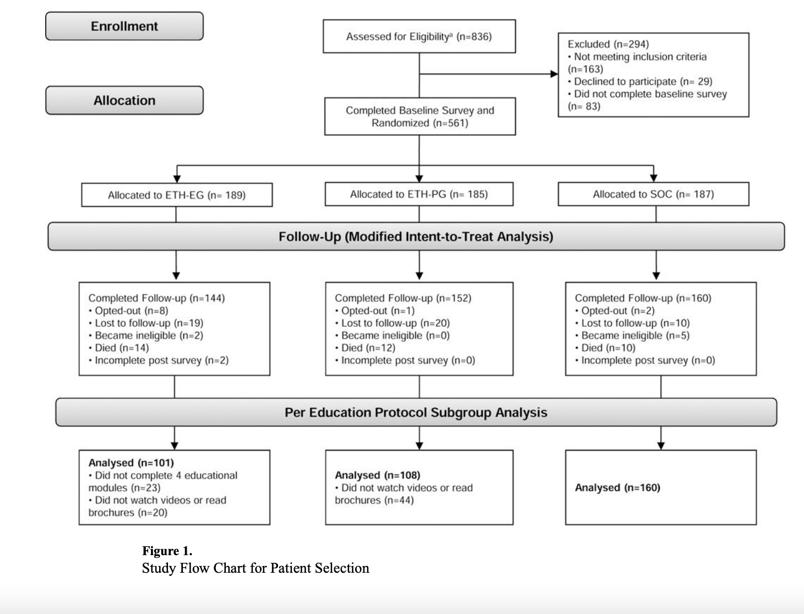

Slide 14
Intervention & Results
Intervention: Patients were randomized to 1 of 3 educational conditions: 1) Standard-of-Care, usual KT education provided in dialysis centers (control); 2) Explore Transplant @ Home Patient Guided, 4 modules of KT education sent directly to patients using print, video, and text messages; 3) Explore Transplant @ Home Educator-Guided, the patient-guided intervention plus four telephonic discussions with an educator.
Results: In intent-to-treat analyses, patients randomized to educator- and patient-guided interventions had greater knowledge gains (1.4 point increase) than control patients (0.8 point increase, p=0.02 and 0.01, respectively). Compared to control patients, more patients randomized to educator- and patient-guided interventions were able to make informed decisions about starting KT evaluation, pursuing DDKT, and pursuing LDKT options.

Slide 15
Clinical Application
Education presented directly to dialysis patients, increased their KT knowledge and informed decision-making without increasing educational burden on providers.
RDs can discuss the importance of diet, and maintaining adherence to help avoid rejection and damage to the new organ.
Encourage patients to talk about their options with family members, so everyone has an understanding of what the patient is going through, and so the patient doesn't feel alone in decision making
Limitations: Potential contamination because of patient-level randomization; no assessment of clinical endpoints.

