Slide 1
How to Become a Registered Dietitian
By: Krystiana Caiati, BS, Sodexo Dietetic Intern

Slide 2
My Experience
I graduated with my Bachelor’s Degree in Nutrition and Dietetics from CUNY Queens College in 2020.
I applied and was matched with Sodexo Dietetic Internship in April 2021
Volunteer experience
I worked as a dietetic technician for 2 years

Slide 3
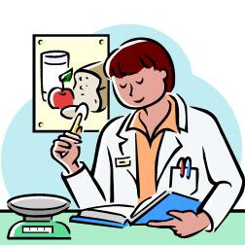
What is a Registered Dietitian Nutritionist
A RDN is a highly trained health professional, recognized as an expert in food and nutrition.
RDN’s help culturally diverse populations/communities achieve positive lifestyle habits.
RDN’s keep up with or contribute to the latest food and nutritional science research.
Notes:
Talk about personal experience

Slide 4
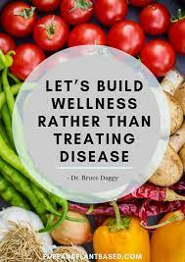
Nutrition and Dietetics is A Booming Field
Employment of dietitians and nutritionists is projected to grow 11% from 2020 to 2030.
About 5,900 job openings for dietitians and nutritionists are projected on average each year.

Slide 5
Requirements To Become A Registered Dietitian Nutritionist
Bachelor’s Degree
Accreditation Council for Education in Nutrition and Dietetics (ACEND)
Academy of Nutrition and Dietetics
Accredited Dietetic Internship (DI) by ACEND
1200 supervised practice hours
National
Complete a Master’s Degree in Dietetics or related field of study
Pass Commission on Dietetic Registration dietetic registered exam
Licensure
regulates the practice of dietetics
Majority of state require this
Maintain continuing education
75 CPEU credits every 5 years.
Notes:
Talk about steps in each bullet

Slide 6
Required Science Courses
DPD Science Courses:
Basic Chemistry
Organic Chemistry
Biochemistry
Anatomy & Physiology
Human Microbiology
Notes:
Talk about sciences needed

Slide 7
Bachelor’s Programs with Degrees in Nutrition and Dietetics in NY
LI/NYC
Herbert H. Lehman College, CUNY, Bronx
Brooklyn College, CUNY, Brooklyn
Long Island University Post, Brookville
Queens College, CUNY, Flushing
Hunter College, CUNY, NYC
New York University, NYC
Upstate, NY
State University of New York at Oneonta, Oneonta
Buffalo State, SUNY, Buffalo
Plattsburgh State University of New York, Plattsburgh
Rochester Institute of Technology, Rochester
Cornell University, Ithaca
Syracuse University, Syracuse
The Sage Colleges, Troy
Notes:
Describe DPD program

Slide 8
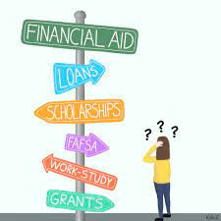
Financial Support
Federal Supplemental Education Opportunity Grants (FSEOG), Pell Grants
Scholarships
Federal work study programs→ provides part-time jobs for undergraduate and graduate students to help pay for college tuition
Student Loans

Slide 9
Ways To Prepare
Receive an Academic High School diploma with a concentration in Math, Sciences etc.
Overall GPA at least 3.0
Take AP undergraduate courses in:
Math
Sciences
Health
English
Participate in Extracurricular Activities :
School Clubs (Math, Science, International Club)
Join the debate team
Obtain leadership positions
Become an elected member in a club
Become captain of a sports team

Slide 10
Ways to Get Involved
Volunteer Opportunities Include:
Clinical Sites - Hospitals
Community Sites - Summer Camps, Community Fairs/Events, Food Pantries/Soup Kitchens, Churches, Community Gardens, Supermarkets

Slide 11
Additional Resources For More Information
Podcasts
Attend College Fairs
Digital magazines
Today’s Dietitian
www.FoodandNutrition.org

Slide 12
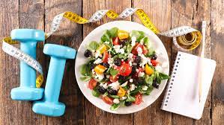
Careers in Nutrition and Dietetics
RDN’s work in:
Hospitals, clinics or other health-care facilities
Sports nutrition and corporate wellness programs
Food and nutrition-related business and industries
Private practice
Community and public health settings
Universities and medical centers
Research areas/ Food Science
Notes:
Talk about additional credentials

Slide 13
“The best way to predict your future is to create it.” -Abraham Lincoln
Notes:
Talk about quote → This is an important quote because it represents how you can do and be anything you want as long as you put your mind to it.

Slide 14
Questions

Slide 15
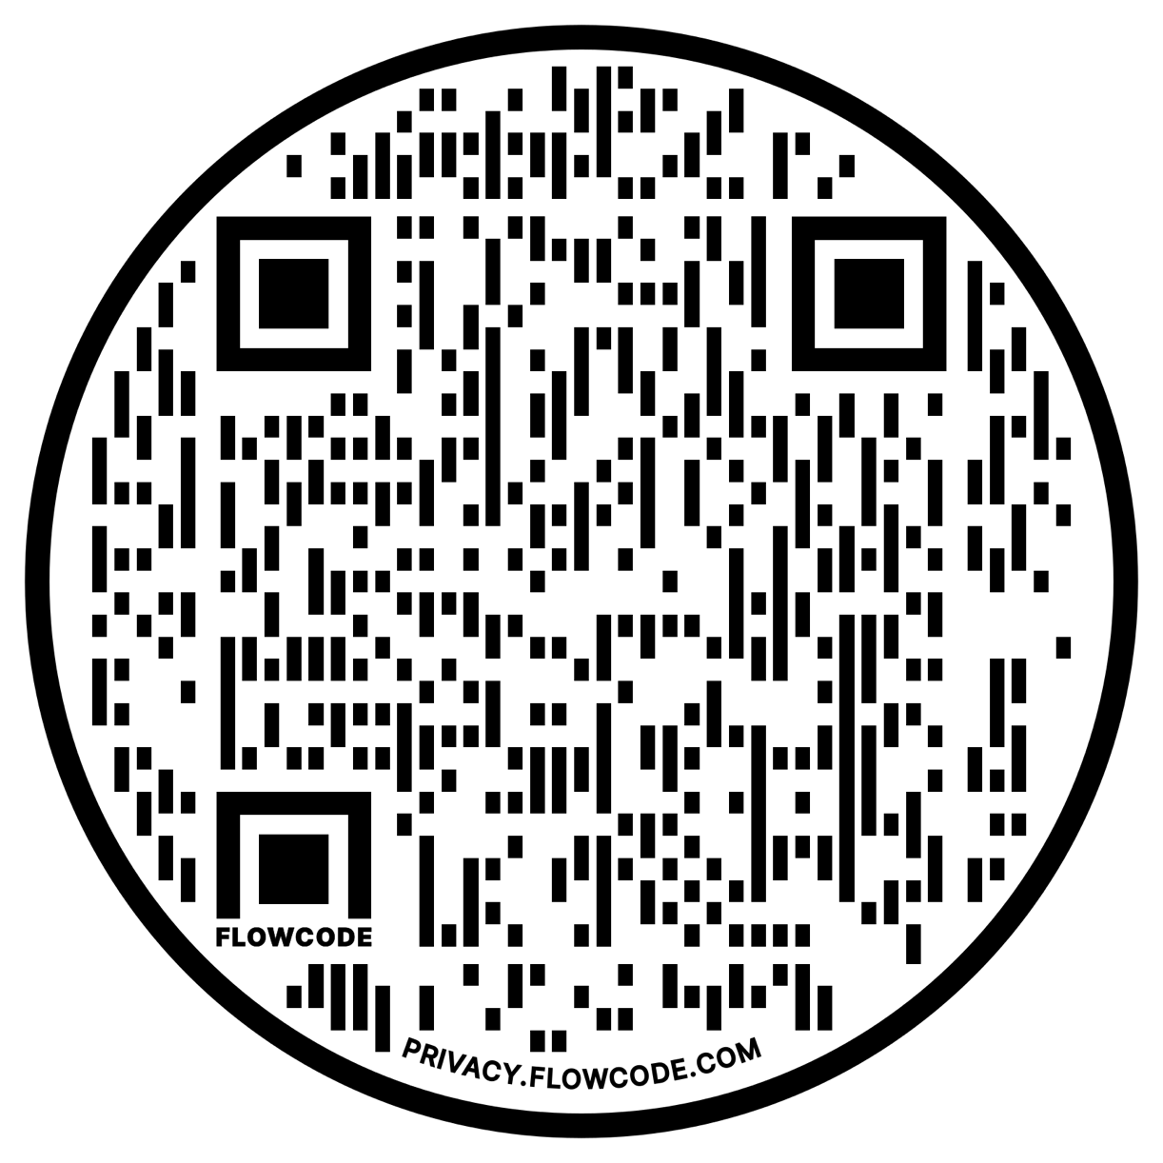
QR Code for Post Presentation Questions

