Slide 1
The Therapeutic Effects of Probiotics and Glycemic Control in Patients with
Type 2 Diabetes
By: Krystiana Caiati
Sodexo Dietetic Intern – Region 3 NYC/Long Island

Slide 2
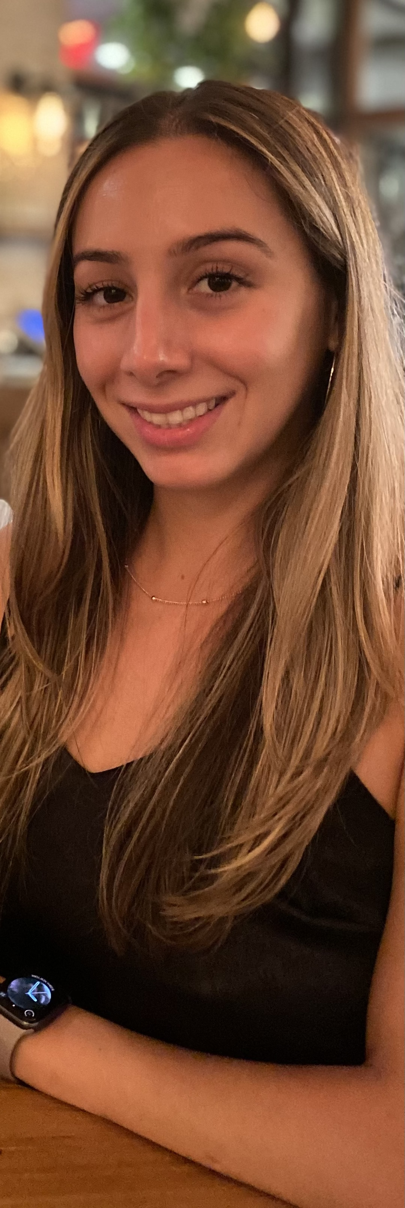
About Me
CUNY Queens College Bachelor’s Degree in Nutrition and Dietetics
Clinical rotation at Mount Sinai South Nassau Hospital
Critical Care MNT Concentration

Slide 3
I would like to thank all of my preceptors throughout my internship experience for all of the knowledge and help you have provided me. I have learned so much from everyone and will use this in my practice when I become a dietitian.

Slide 4
Learning Objectives
Describe the effects of probiotics on glycemic control in patients with Type 2 Diabetes (T2DM)
Discuss current evidenced-based research on T2DM and probiotics
Explain how to apply the knowledge from this presentation into practice

Slide 5
Evidence of Disclosure of Conflicts of Interest
I have no conflicts of interest including no sources of compensation related to the activities/materials

Slide 6
U.S. Diabetes Stats
1.4 million Americans diagnosed with diabetes each year
14.5% American Indian/Alaskan Native
12.1% non-Hispanic black
11.8% Hispanic
9.5% Asian American

Slide 7
Summary
Evidence that supports probiotics have a beneficial effect on HbA1c, FBG, and HOMA-IR levels in people with T2DM
Long-term effects of probiotics along with which strains are optimal for management of T2DM
Probiotics along with Metformin are helpful in reducing FBS
Factors affecting probiotic effectiveness: strain(s), health condition, duration of use, dose, and diet/lifestyle

Slide 8
Application to Dietetics Practice
Food first – Suggest incorporating probiotic rich foods daily into the diet
Lifestyle – Encourage daily exercise (walking, biking, yoga), most people live a sedentary lifestyle
Eating behavior – Keep food journals to track daily habits, common foods eaten
Culture –It is important to understand the staple foods a person might eat and which ethnicities might consume more probiotic rich foods

Slide 9
References
Perraudeau, Fanny et al. ``Improvements to postprandial glucose control in subjects with type 2 diabetes: a multicenter, double blind, randomized placebo-controlled trial of a novel probiotic formulation.” BMJ open diabetes research & care vol. 8,1 (2020): e001319. doi:10.1136/bmjdrc-2020-001319
Khalili, Leila et al. “The Effects of Lactobacillus casei on Glycemic Response, Serum Sirtuin1 and Fetuin-A Levels in Patients with Type 2 Diabetes Mellitus: A Randomized Controlled Trial.” Iranian biomedical journal vol. 23,1 (2019): 68-77. doi:10.29252/.23.1.68
Kassaian, Nazila et al. “The effects of probiotic and synbiotic supplementation on metabolic syndrome indices in adults at risk of type 2 diabetes: study protocol for a randomized controlled trial.” Trials vol. 18,1 148. 29 Mar. 2017, doi:10.1186/s13063-017-1885-8
Madempudi, Ratna Sudha et al. “Efficacy of UB0316, a multi-strain probiotic formulation in patients with type 2 diabetes mellitus: A double blind, randomized, placebo-controlled study.” PloS one vol. 14,11 e0225168. 13 Nov. 2019, doi: 10.1371/journal.pone.0225168
Palacios, Talia et al. “Targeting the Intestinal Microbiota to Prevent Type 2 Diabetes and Enhance the Effect of Metformin on Glycaemia: A Randomized Controlled Pilot Study.” Nutrients vol. 12,7 2041. 9 Jul. 2020, doi:10.3390/nu12072041
Rittiphairoj, Thanitsara et al. ``Probiotics Contribute to Glycemic Control in Patients with Type 2 Diabetes Mellitus: A Systematic Review and Meta-Analysis.” Advances in nutrition (Bethesda, Md.) vol. 12,3 (2021): 722-734. doi:10.1093/advances/nmaa133
Tao, Yun-Wen et al. “Effects of probiotics on type II diabetes mellitus: a meta-analysis.” Journal of translational medicine vol. 18,1 30. 17 Jan. 2020, doi:10.1186/s12967-020-02213-2
Tompkins, T A et al. “The impact of meals on a probiotic during transit through a model of the human upper gastrointestinal tract.” Beneficial microbes vol. 2,4 (2011): 295-303. doi:10.3920/BM2011.0022

